Slide 1
Computer Memory

Slide 2
Computer Memory
Computer Memory is a device which stores information that is currently being utilized/used by the operating system, Application software, hardware devices. Etc.
Types of computer memory
There are two types of computer memory.
Primary memory/main memory
Secondary memory

Slide 3
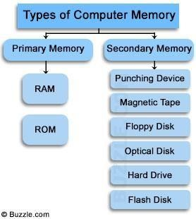

Slide 4
Primary memory/Main memory
The Primary storage unit (main memory) hold data and instructions between processing steps and supplies them to the CU and ALU during processing.
All data and programs must be placed into main memory before they can be processed.
The primary storage unit consists of microelectronic semiconductor memory chips. This includes RAM (random access memory) for loading programs and data before execution, and ROM (read only memory) for permanent programs that are supplied with the computer.

Slide 5
Random Access Memory (RAM)
RAM: Is the main memory space of your computer which is considered as temporary or volatile memory, this means that the contents of RAM are lost when the Computer power is turned off.
The RAM is the workspace of your computer. If your computer has more RAM, it can open more and larger programs and documents simultaneously.
The documents you are currently editing, typing, formatting, and the programs your computer is using are stored in the RAM. Note: RAM capacity is expressed in ―Megabytes‖ (MB)

Slide 6
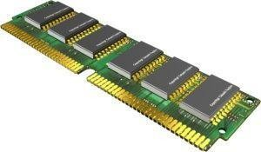
RAM
.

Slide 7
Characteristics of RAM
It is located near the CPU and hence store data immediately after CPU processes them.
RAM is a primary storage.
RAM is a volatile storage.
RAM has little storage capacity.
RAM is a temporary storage.
RAM has high speed compared to ROM
RAM is electrically dependent

Slide 8
Read Only Memory
ROM: Is non- volatile memory; this means that the contents of ROM are not lost when the computer power is turned off. So ROM stores data permanently. Data stored in ROM cannot be altered easily; since it was created by the manufacturer of the computer.
ROM has low speed compared to RAM.

Slide 9
Characteristics of ROM
ROM stores data permanently
ROM is non-volatile storage
ROM has low speed compared to RAM
Data stored in ROM can not be altered easly.

Slide 10
Differences between Main memory and secondary memory
primary memory
Secondary memory
Fast
Low capacity
Works directly with the processor
Store data temporarily
It is electrically dependent
Slow
Large capacity
Not connected directly to the processor
Store data permanently
It is not electrically dependent

Slide 11
Secondary Memory
Secondary storage is used for long term (permanent) storage of data and programs. The use of secondary storage devices such as magnetic disks and optical disks greatly enlarge the storage capacities of computer systems.
Before the contents of secondary storage can be processed, they must be brought into the primary (main) storage unit.
Secondary memory is where programs and data are kept on a long-term basis. Examples of secondary memory are HDD,CD‘s, Flash disk.
When you save your work, it does not go into ROM, it goes to the other storage devices like HDD.

Slide 12
Standard unit of measuring computer storage capacity
Bit: This is the smallest unit of measuring computer storage capacity and size. A bit is a single 0 or 1.
Byte: This is a group of 8 bits. It is equal to one character.
A character is a letter, number or symbol that can be typed on a keyboard.
Nibble: This is a group of 4 bits. It is a half a byte.
Kilobyte (KB): This consists of 1024 bytes, approximately 1000bytes. 1KB is about 140 words.

Slide 13
Cont’d
Megabyte(MB): This consists of 1024 kilobytes (about 1000KB).
One megabyte equals about 1,000,000 bytes
1MB equals about 500 pages of text, or one large book.
Gigabyte (GB): It consists of 1024 megabytes (about 1,000,000,000 bytes)
One gigabyte equals about 1000 MB
One gigabyte equals about 1,000,000 KB
One gigabytes equals about 1,000,000,0000 bytes
1GB equals over 1,000 books of text.

Slide 14
Storage capacity management
1 Byte = 8 Bits
1 Character = 1 Bytes
1 Kilobyte (KB) = 1024 Bytes
1 Kilobyte = 1024 Character
1 Megabyte (MB) = 1024 KB
1 Gigabyte (GB) = 1024 MB
1 Terabyte (TB) = 1024 (GB)
1 Petabyte (PB) = 1024 TB

